Slide 1
DevOps Methodology
Dana Edwards

Slide 2

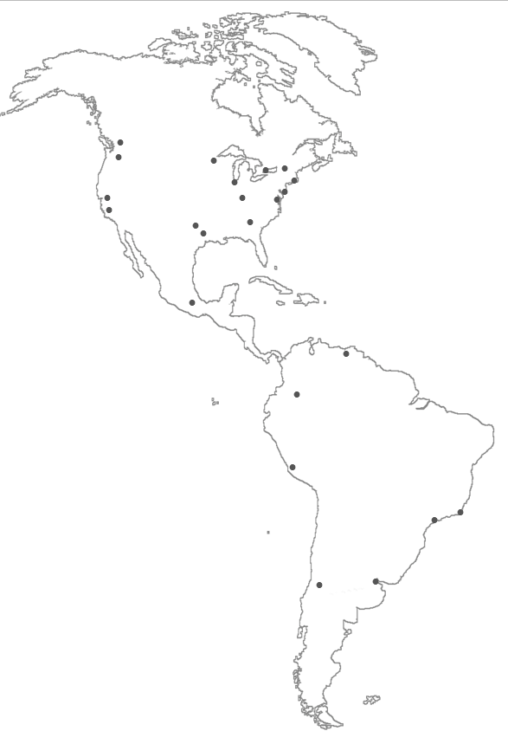
Corporate Profile
Full-service bank with offices across the United States
Provide corporate, commercial, retail banking, wealth management, investment banking, personal trust, capital markets, global treasury, and transaction banking
Assets of $108.8 billion (USD) as of June 30, 2014
One of world’s largest financial organizations with total assets of $2.5 trillion (USD) as of June 30, 2014

Slide 3

Who We Are
We build technology for customers, clients and companies to perform their financial transactions when and how they want.
FOCUSED ON BECOMING THE WORLD’S FINEST TECHNOLOGY ORGANIZATION
full time technologists
Data Centers
Resources based in
712
Supported by
724
17
different states
and across multiple offshore locations
in Los Angeles, California and Chandler, Arizona
of diverse backgrounds
contractors

Slide 4

Business Drivers in Application Economy
Challenging regulatory landscape
Macro- economic factors
Enterprise prioritization
EXTERNAL
Becoming Top Ten U.S. Bank
INTERNAL
Aggressively competitive industry
Balancing growth with investment
Expense pressures

Slide 5

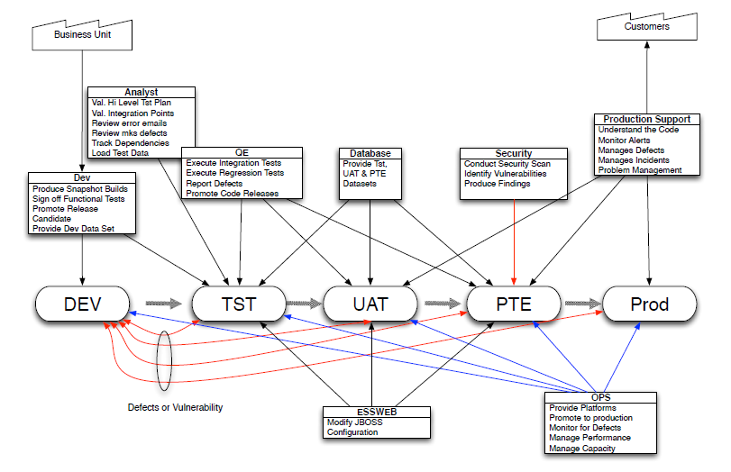
Development & Operations Segmented Process

Slide 6
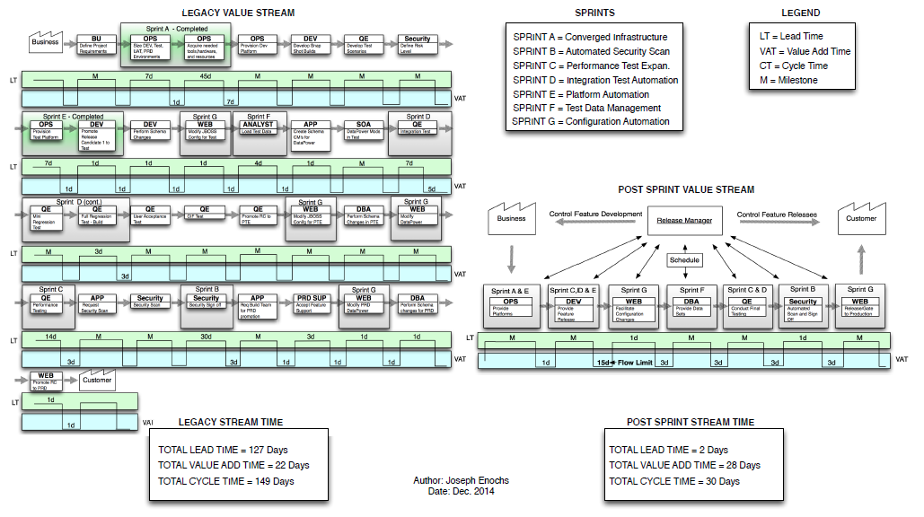
Value Stream Diagrams

Slide 7
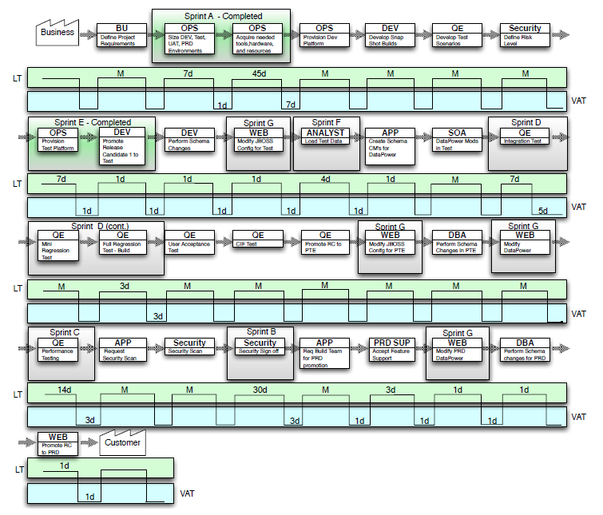
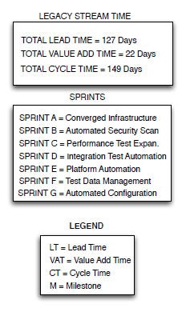
Legacy Stream Diagram

Slide 8
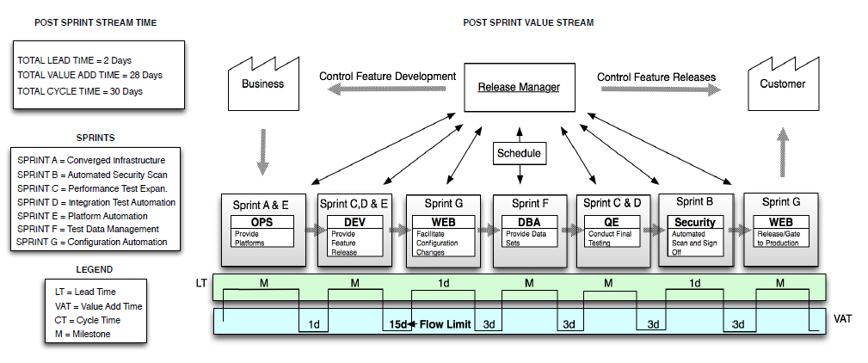
Post Sprint Stream Diagram

Slide 9






IT Challenges in the Application Economy
Cut the time and costs it takes for growth with a limited IT staff
Pressures from business to release apps more quickly to meet customer demand
Improve application testing when replacing legacy systems
Improved collaboration
Need to improve the end customer experience
Increased use of mobile devices
The fast delivery of new products and services is the priority

Slide 10
DevOps Transformation Methodology that combines separate and sequential processes of application development and operations into a continuous and collaborative process.
PEOPLE
PROCESS
TECHNOLOGY
Develop people strategy that addresses how we attract, select, develop, energize, value our employees
Rebuild IT organization with key senior roles, subject matter experts, centers of excellence
Implement industry-standard processes to improve execution and delivery
Tackle information security practices and strategies addressing capabilities
Establish governance and oversight to provide transparency, ensure adequate controls
Leverage best practices to build a strong foundation for growth
Implement service virtualization to modernize testing practices and anticipate problems
Mine customer feedback for improved quality and sustainability
Notes:
Key Components to DevOps
IT automation
Agile development
Collaborative teaming between dev & ops
Service virtualization
Accelerated applications testing
Continuous release cycles
Aligned processed across dev & ops
Pre-production performance testing

Slide 11

DevOps Technology
COLLABORATION
Service Virtualization and Application Testing
Increase speed and quality: Simulate more testing scenarios during application development and in less time
Anticipate Problems: Mimic changes that are taking place on the backend, while simulating how those changes affect front end applications
“It’s one thing to make the release date, but if we also release a superior product, under budget, with minimum defects and stress tested for maximum loads using the benefits of simulation — that’s even better!”
Notes:
Increased quality in testing process leads to fewer issues in production
Ability to anticipate problems instead of react

Slide 12
Our Results
10 hours to 1 hour
Reduced downtime due to refreshing test environments
65-85%
Cost reduction for testing cycles
Reduction in application development time
42 days to 3 days
Reduced time to set up development environments
3.5 months
“In order to compete and get in to the top 10 we need to move quicker, more responsibly and with better quality, This [solution] is changing our identity to be more nimble to keep up with our business needs.”

Slide 13
DevOps Methodology
Dana Edwards
Chief Technology Officer
Thank you for your interest.

